Slide 1
Location Recommendation
Carlton Mezetin

Slide 2
Goal
In order to find the best locations the top zip-code in Sales became the goal.
To do this first we looked at the top counties
Due to the large margin of Sales from the top county. I determined that the top producing zip-codes would be located in that county.

Slide 3
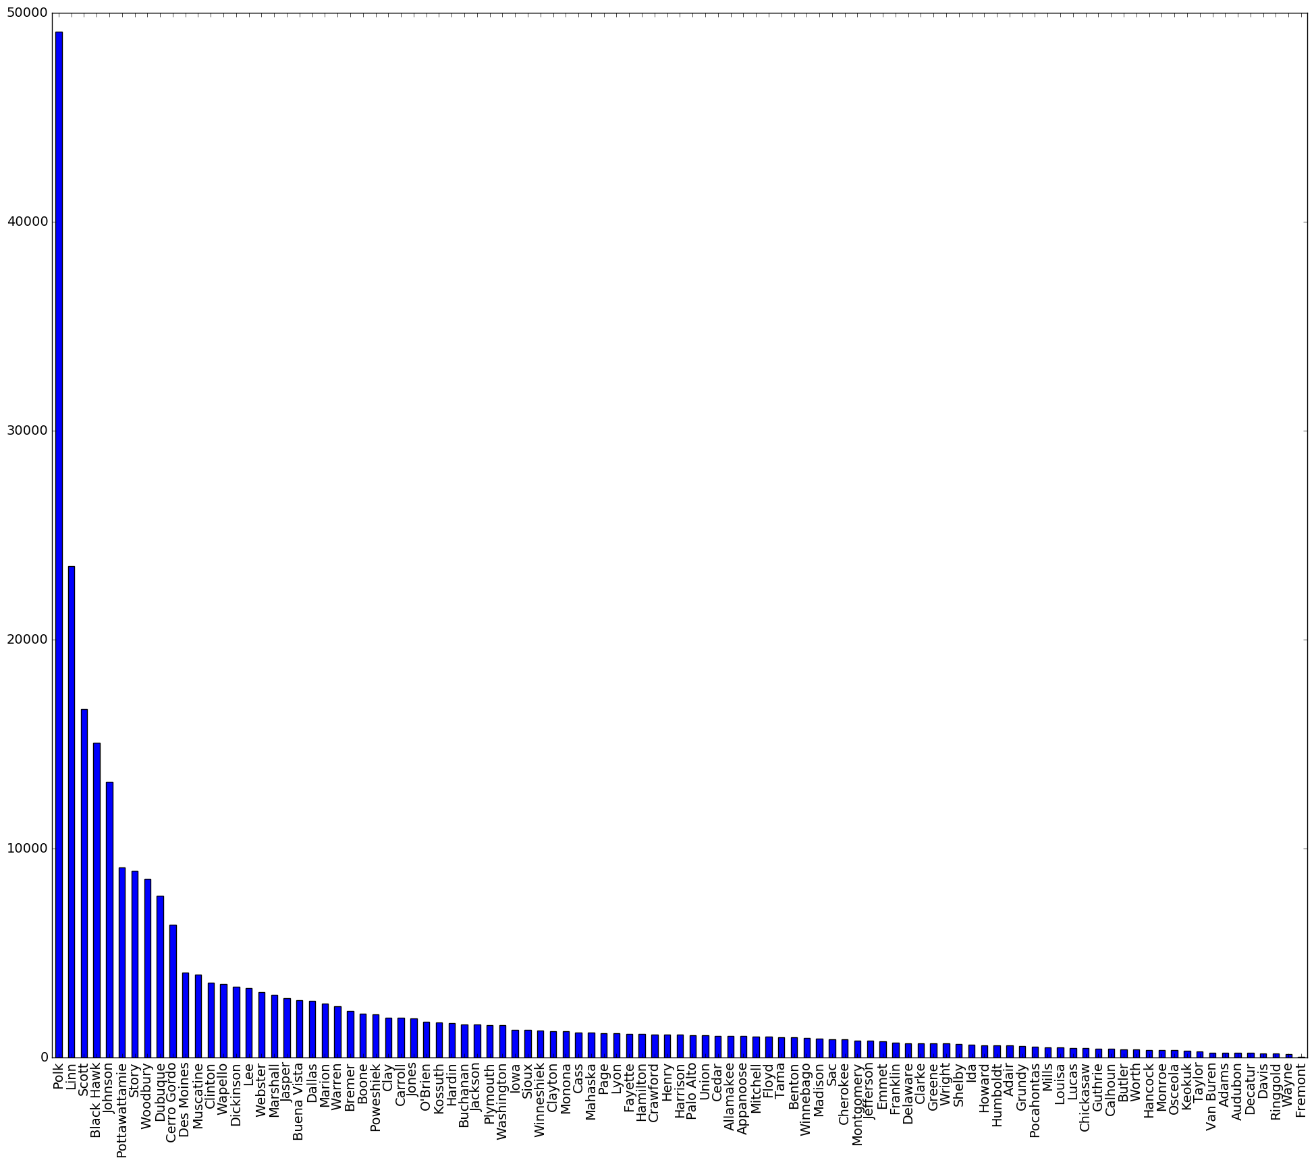
Sales By County

Slide 4
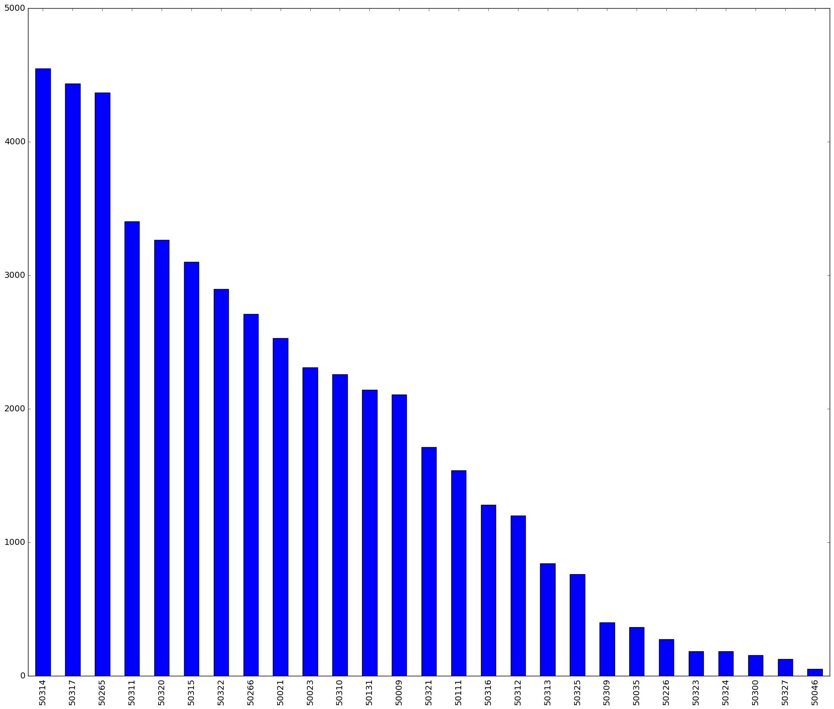
Sales by Zipcode

Slide 5
Recommendation
The top Producing County is Polk
The location for you store should be located in one three zip-codes
50317
50314
50265
Useful tips
Bottles Sold and Volume of Gallons

